Slide 1
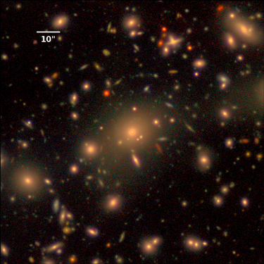
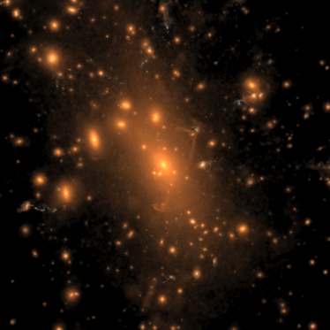


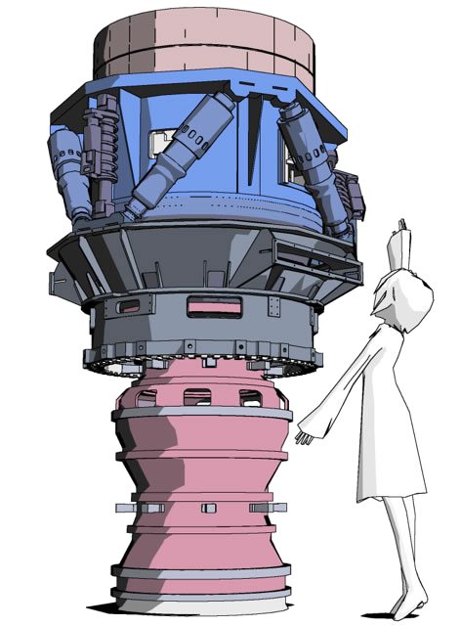
Stellar Profiles of Massive Galaxies:
Hyper Suprime-Cam Survey Hydrodynamic Simulations
vs.
Felipe Ardila¹
Alexie Leauthaud¹, Song Huang¹,
Benedikt Diemer², Annalisa Pillepich³
¹ UC Santa Cruz, ²CfA, ³MPIA
Notes:
Simulation: Stellar light distribution (rest-frame B,g,r band composites) of the most massive cluster in the simulation volume, at z=0.

Slide 2
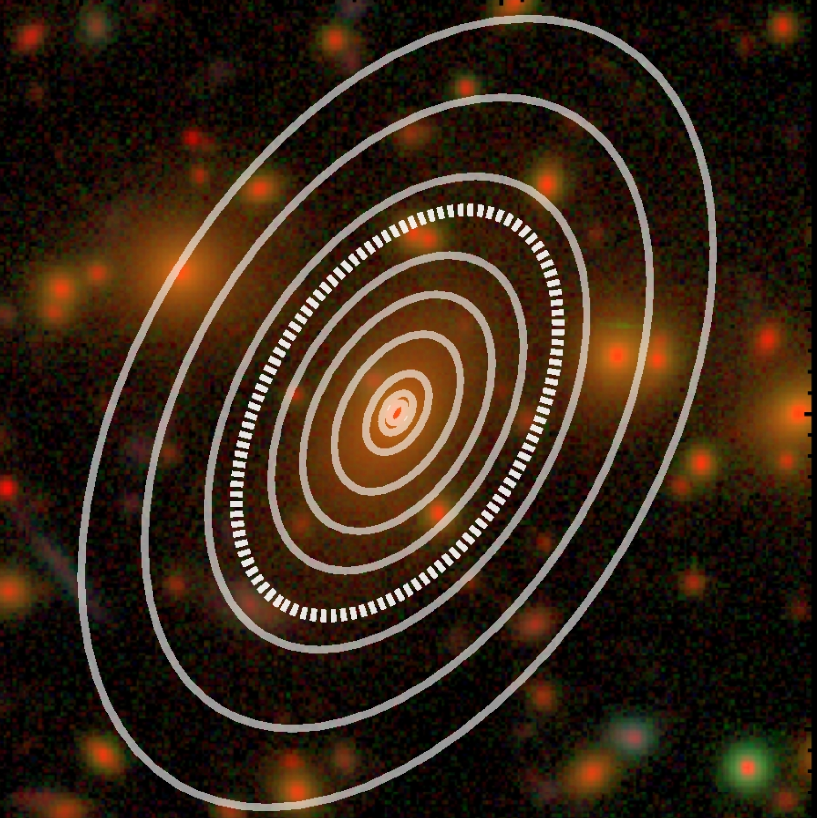
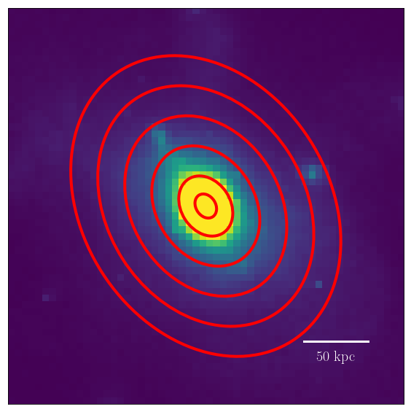
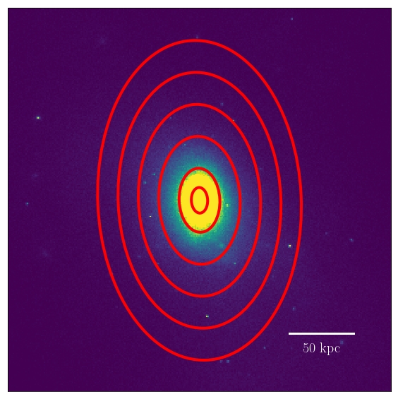
Observations
Hydrodynamic Simulations
HSC
Illustris
TNG100
Consistent methodology between observations and simulations
(Huang et al. 2018)
Weak Lensing data
Notes:
We want to do deatailed comparisons between these
We do things in a way that is consistent with how we do this in the data - Huang et al
We also have lensing
(I will of introduced these concepts earlier)

Slide 3
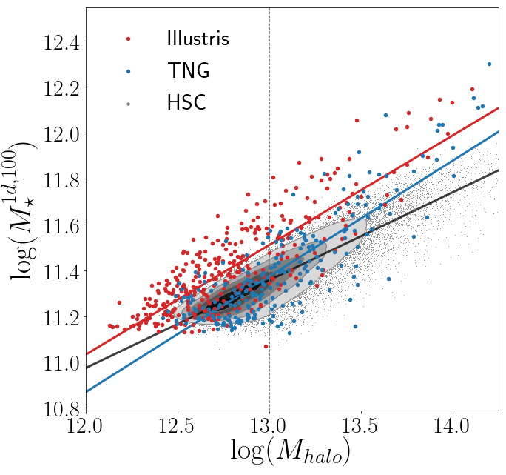
M★^{1d, 100} vs. M_{halo}
Notes:
Explain that we can match Halo because we have the lensing

Slide 4
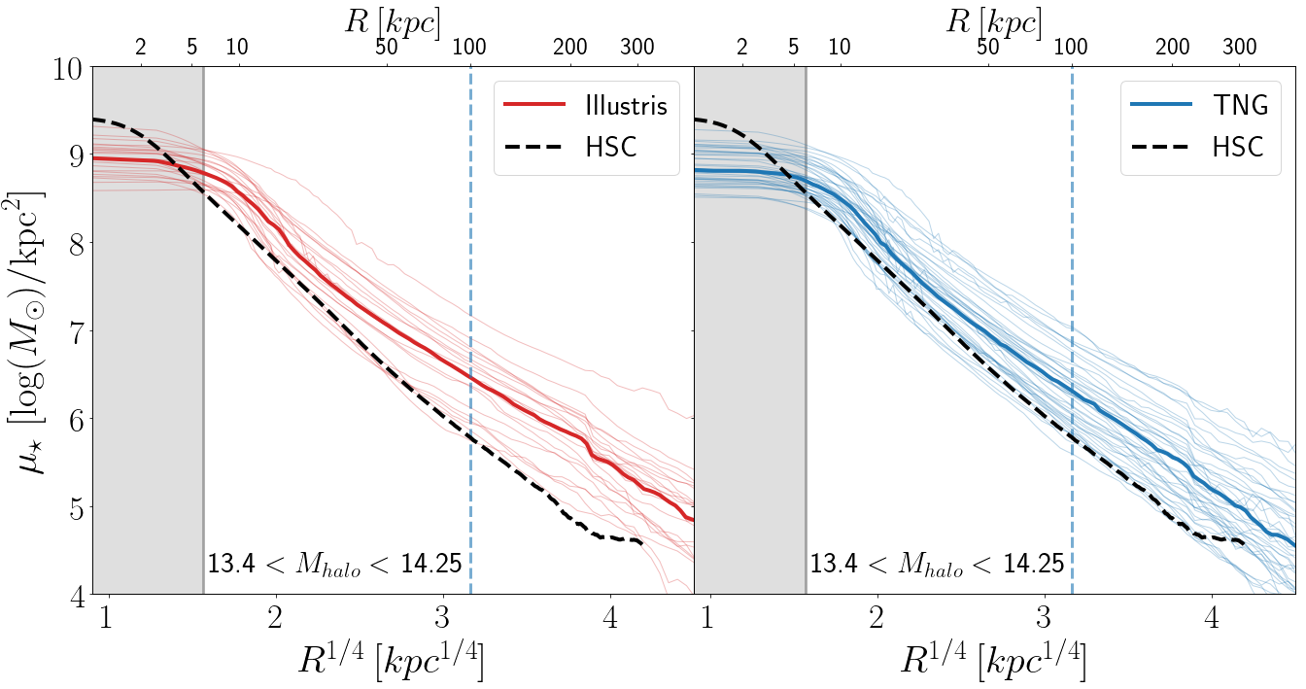
Matched by M_{halo}
Notes:
Show the profiles matched by Mhalo (with the inner parts fixed with the new high resolution maps)

Slide 5
Stellar Mass Functions

Slide 6



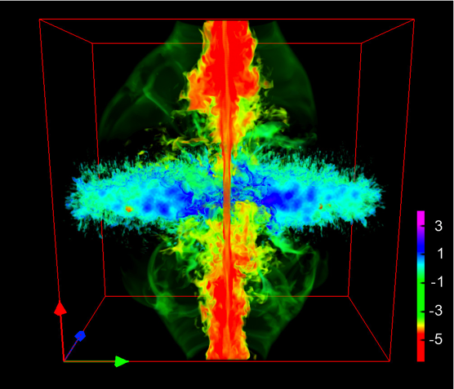
Main Takeaways:
HSC provides beautiful data to help with the calibration of hydro simulations
Getting X-ray masses for this same set of galaxies will help calibrate the simulations further
AGN feedback
baryonic effects
vs.
Notes:
https://nl.pinterest.com/pin/514465957424466757/
http://inspirehep.net/record/1122490/plots

